Slide 1
Anti-Sleep Alarm System
Sinhgad College of Engineering, Pune
Department of E&TC
T. E. E&TC - (Mini – Project)
Group No: C14
By
Aditya Ramesh Tambe T400230894
Pranjal Jaywant Pakale T400230805
Niketan Shivaji Sarode T400230863
Guide: Dr. T.V. Kafare
2024-25, Sem: II

Slide 2
Contents
Introduction of the projects
Aim and Objectives
Block Diagram
Circuit Diagram
Hardware and Software Requirements
Simulation Results
Applications of the Project
Conclusion
References

Slide 3
Introduction
The Antisleep Alarm System is utilized to prevent accidents caused by drowsiness by detecting early onset of sleep and alerting the user. The system is particularly beneficial to drivers, machine operators, and other individuals who need to stay awake for safety reasons.

Slide 4
Aim & Objectives
Aim:
To develop a system that detects drowsiness and provides an alert to prevent accidents.
Objectives:
Ensure real-time monitoring of the user's alertness.
Use sensors to detect signs of sleep, such as eye blinking.
Generate immediate alarms to wake up the user.
Improve safety in high-risk activities like driving and industrial work.

Slide 5
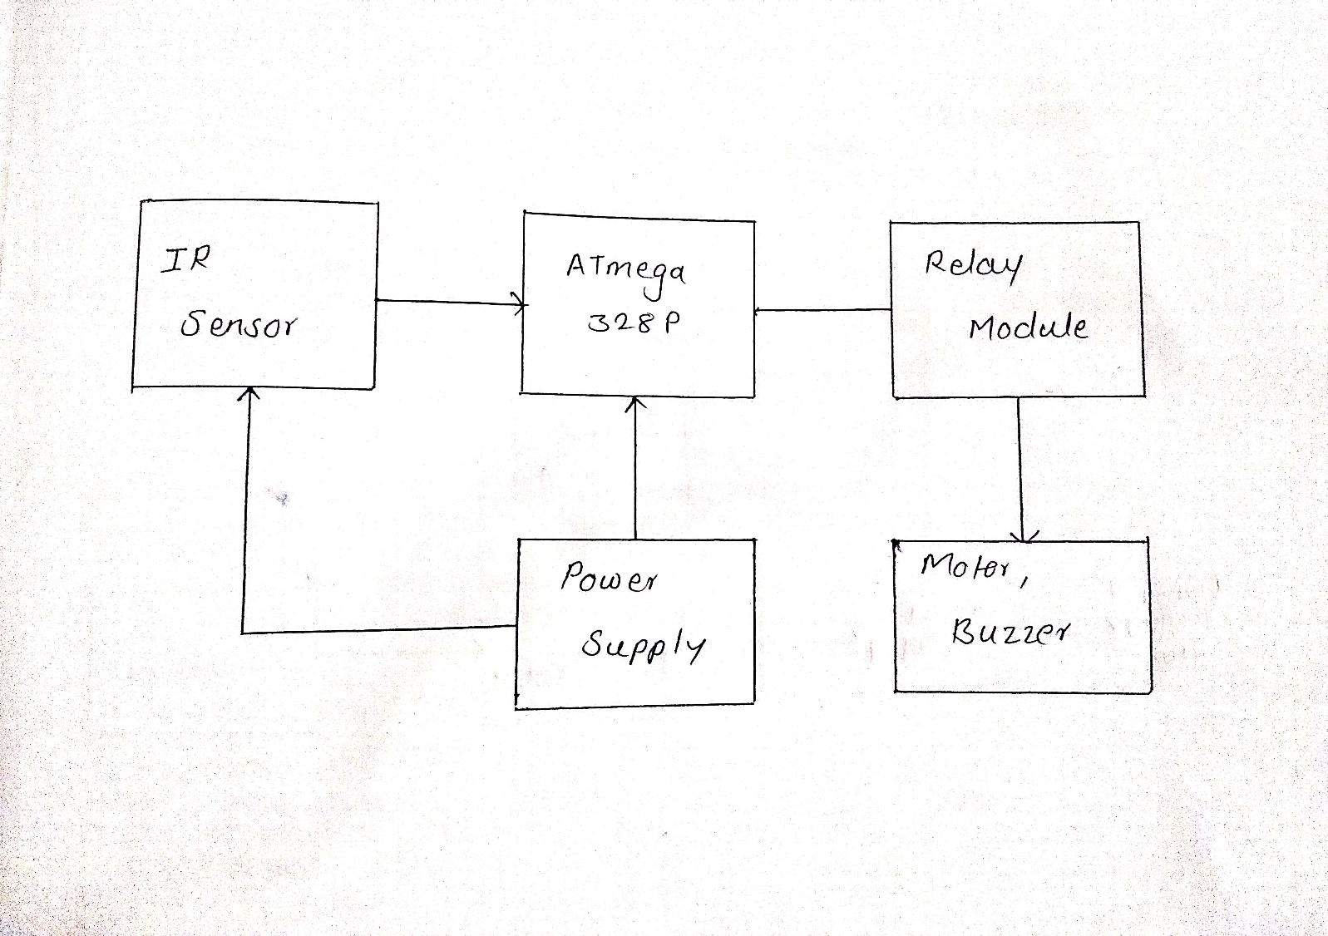
Block Diagram

Slide 6
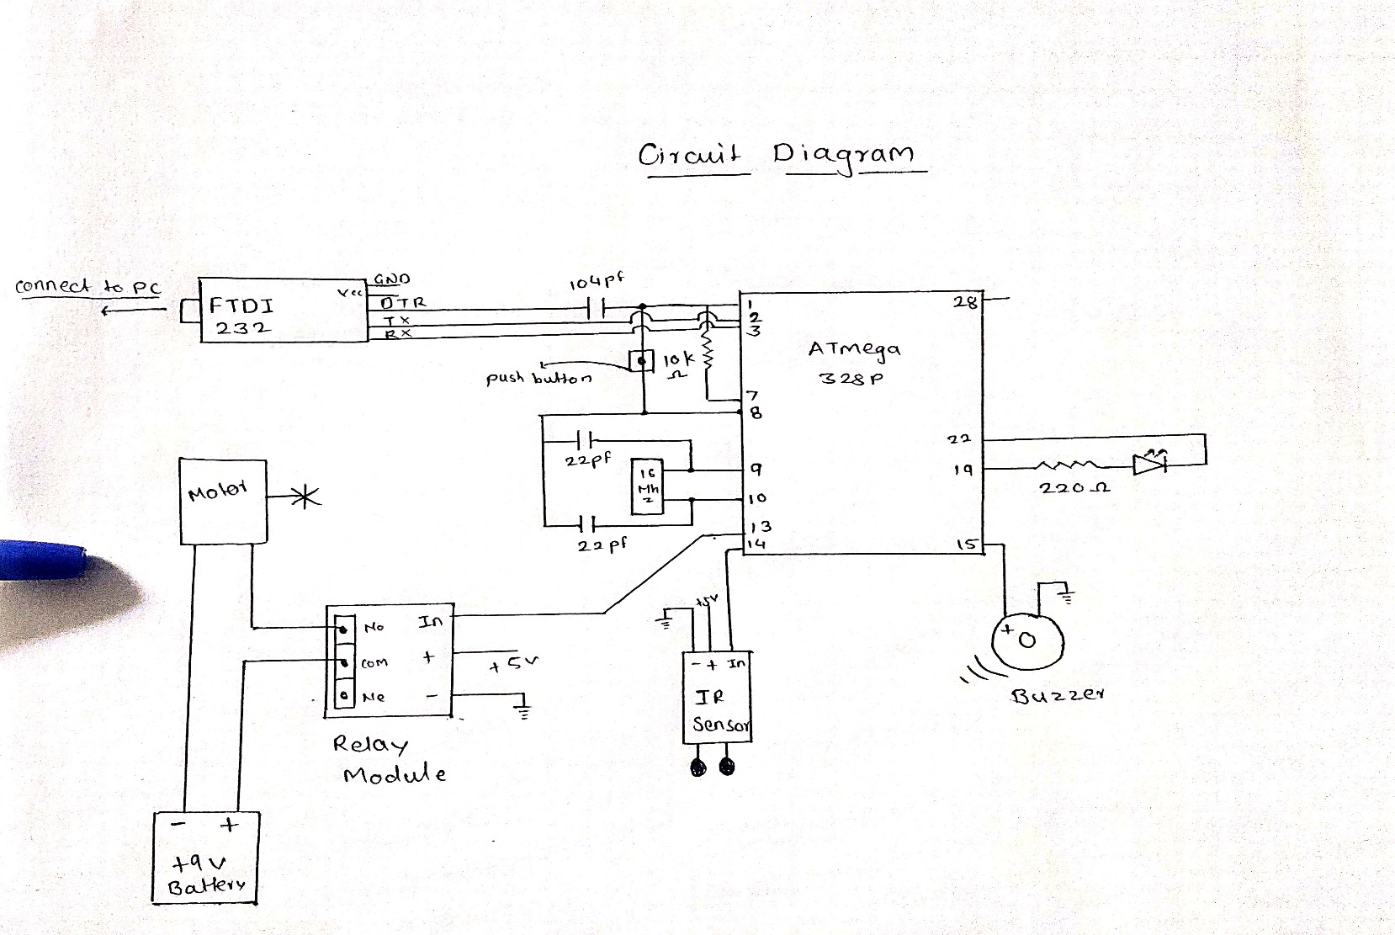
Circuit Diagram

Slide 7
Hardware ad Software Requirements
Hardware Requirements:
Microcontroller (e.g., Arduino Uno, PIC, 8051, etc.)
IR Sensor or Eye Blink Sensor
Buzzer or Alarm System
Power Supply (Battery or Adapter)
Connecting Wires and PCB Board
Software Requirements:
Arduino IDE (for coding and uploading the program)
Embedded C / C++ programming
Proteus (for circuit simulation)
MATLAB or Python (if additional processing is needed)

Slide 8
Simulation Results
If you have conducted a simulation of the circuit, this slide should include the results.
Mention how the system responds when the sensor detects drowsiness.
Include screenshots of any simulations from Proteus, Tinkercad, or Arduino Serial Monitor.

Slide 9
Applications
Prevention of Road Accidents: Helps drivers stay awake and alert.
Industrial Safety: Prevents accidents in workplaces where alertness is required.
Medical Monitoring: Can be used in hospitals to monitor patients for drowsiness.
Military Applications: Useful in defense and surveillance operations.

Slide 10
Conclusions
The Antisleep Alarm System effectively detects drowsiness and provides an alert.
It helps in preventing accidents caused by fatigue in critical tasks like driving and industrial work.
The project can be further improved by integrating AI-based facial recognition
or heart rate monitoring for better accuracy.

Slide 11
References
Research Papers & Articles:
Drowsiness Detection Using Eye Blink Sensors (IEEE Xplore - If you used research papers)
Driver Fatigue Detection System (ScienceDirect - If applicable)
Arduino & Embedded Systems:
Arduino Official Documentation: https://www.arduino.cc/
IR Sensor Interfacing with Arduino: https://circuitdigest.com/
Circuit & Simulation Tools:
Proteus Simulation Guide: https://www.labcenter.com/
Tinkercad Online Circuit Design: https://www.tinkercad.com/
Project Tutorials & DIY Resources:
Instructables - DIY Anti-Sleep Alarm: https://www.instructables.com/
Electronics Hub - Drowsiness Detection Project: https://www.electronicshub.org/

Slide 12
Thank You

